Slide 1


PA 604
Professor Burrel Vann Jr
A BRIEF NOTE ON
UNOBTRUSIVE RESEARCH

Slide 2
Methods of studying social life without affecting it
Can be:
Qualitative
Quantitative
Unobtrusive Research
Notes:
Content analysis: analyzing the content of social artifacts (written documents/newspaper editorials)
Existing statistics: Demographic data published by governments (Durkheim’s study of suicide rates)
Comparative historical:
Example, wanting to know which paintings at a museum are most popular: instead of surveying people to find out which ones they liked better, or watching people go into each exhibit and counting them (all of which could have some effect on the people and their responses), the researchers observed the wear-and-tear on the ground in front of each exhibit (the one with the most wear was the most popular)… and finding which ones kids like more… look for mucus on glass in front of exhibit…
-its like you’re a crime detective… looking for clues of relationships without having been there

Slide 3
Qualitative
Content Analysis/Text Analysis
Case Study (Historical)
Comparative Historical
Quantitative
Secondary Data Analysis
TYPES OF UNOBTRUSIVE RESEARCH
Notes:
comparative historical

Slide 4
CONTENT ANALYSIS
The study of recorded human communications (text).
Can be books, newspapers, websites, paintings, laws, blogs, texts, etc.
“Who says what, to whom, why, how, and with what effect?”
Key Questions
What are your operational definitions?
What will you observe?
How will you analyze the data?
How will you measure your key variables?
What are your units of analysis?
Notes:
What is the role of movements in the legalization of marijuana? Take newspaper articles about legalization, and code for the presence of the movement, and what it says about marijuana legalization… and the proportion that is dominated by the movement, compared to other factors…
Or, like Ida B. Wells, who wanted to understand whether black men were primarily being lynched for assaulting white women… she looked at newspaper articles on over 700 lynchings reported during the previous 10 years… and found that black lynched were only accused of white women assault in 1/3 of cases (not proven guilty)

Slide 5
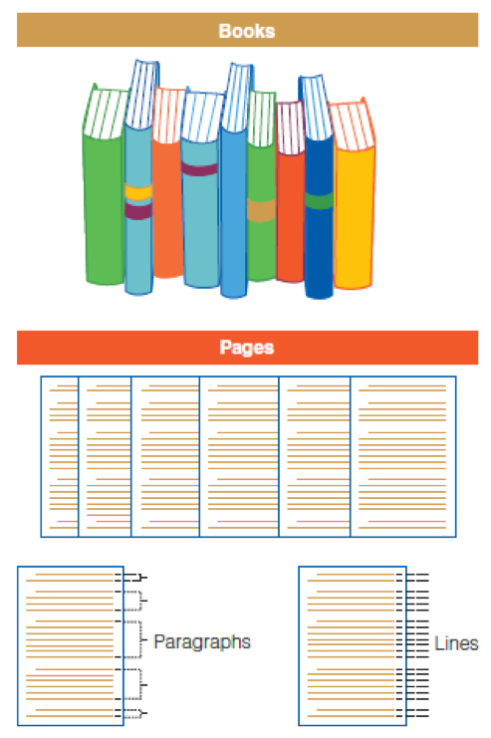
CONTENT ANALYSIS
Units of Analysis

Slide 6
CONTENT ANALYSIS
Sampling
Any conventional sampling technique may be used for content analysis.
Notes:
Simple random sample of children's books, if you have the sampling frame. Stratified random or systematic sampling if you have strata that are important.

Slide 7
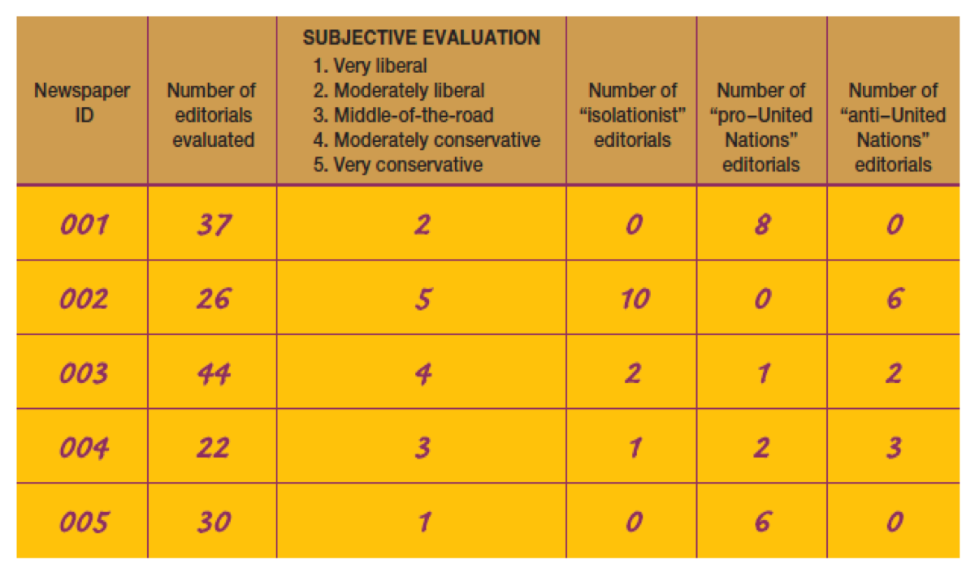
CONTENT ANALYSIS
Coding
Transforming raw data into a standardized form for analysis.
Notes:
e.g. Newspaper can be coded as liberal or conservative, books as romantic or not, etc

Slide 8
CONTENT ANALYSIS
MANIFEST CODING
LATENT CODING
The concrete terms contained in a communication.
involves the counting of specific elements, such as the word love, to determine whether and to what degree the passage should be judged “romantic.”
The underlying meaning of communication.
view entire unit of analysis (a paragraph in this case) and make a subjective assessment regarding whether and to what degree it is “romantic.”
Coding Types
Notes:
Trying to measure how romantic a novel is, you count the number of times the word love, kiss, hug, etc show up in the text. Manifest is just measuring actual things that are written, in a standardized form (all words in this list count as romantic).
Very reliable, because we know precisely how romance is measured. However, just counting these words might not get at the true character of romance… so while reliable, they might not be valid measures of romance.
Coding for it’s underlying meaning. Might read a sample of a paragraph/few lines, and make a subjective interpretation of whether or not the section is “truly” romantic. While your interpretation may be based on “the number of times the word love shows up”, it’s not the be-all, end-all measure.
Although you may be getting at the true nature of romance in novels, you lose some points for reliability (since other researchers might interpret the same passage differently).
If possible, use both methods.

Slide 9
CONTENT ANALYSIS
STRENGTHS
WEAKNESSES
Time and money
Correction of errors
Study of processes occurring over time
Research has virtually no effect on subjects
Reliability
Limited to recorded communications
Validity
Coding Types

Slide 10

SECONDARY DATA ANALYSIS
Using quantitative data collected by other researchers
survey responses
administrative data
Census data: city, county, state-level (e.g. crime, voting, education, non-profits, organizations, events,

Slide 11
SECONDARY DATA ANALYSIS
Units of Analysis
Individual
Groups
City, County, State
Notes:
Ecological Fallacy:
Existing statistics rarely come at the individual level, so we have to make claims at higher levels. But he could make a pretty strong claim about individuals, without saying individuals or really studying them… by finding the pattern in countries, regions, and states…

Slide 12
SECONDARY DATA ANALYSIS
Sources of Existing Statistics:
Statistical Abstract of the United States
Census
Pew Research Center
Public Policy Institute of California’s Data Depot
The World Bank Data Catalog
The Inter-university Consortium for Political and Social Research
Notes:
Ecological Fallacy:
Existing statistics rarely come at the individual level, so we have to make claims at higher levels. But he could make a pretty strong claim about individuals, without saying individuals or really studying them… by finding the pattern in countries, regions, and states…

